Slide 1
Concluding The Interview
Notes:
1

Slide 2
Miscellaneous Tax Forms Federal Section \ Miscellaneous Forms
Pub 4012 Tab O
Determine need for any miscellaneous tax forms
Injured Spouse Form (Form 8379)
Claim a Refund Due to a Deceased Taxpayer (Form 1310)
Application for Extension (Form 4868)
Married Filing Separately Allocations (Form 8958)
IRS Identification Pin
Installment Agreement (Form 9465)
Application for ITIN (Form W-7)
Power of Attorney and Declaration of Representative (Form 2848)
Find these forms in Federal section \ Miscellaneous Forms
Complete each as appropriate
Notes:
2

Slide 3
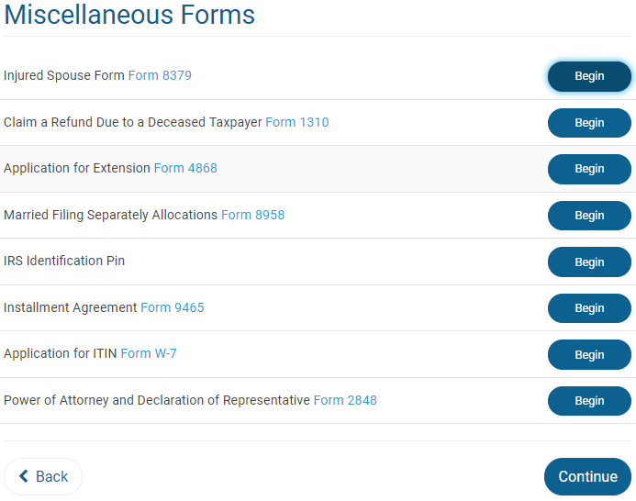
TS – Miscellaneous Forms
Notes:
3

Slide 4
Identity Theft
Pub 4012 Tab P
Identity Theft is the fraudulent acquisition of a person’s private identifying information, usually for financial gain
IRS sends notices to known taxpayer victims (or potential victims)
Letter includes 6-digit Identity Theft Protection PIN for filing return (reissued each year)
Can be issued to taxpayer, spouse, or any dependent
Counselor should routinely ask taxpayer about this
Enter in Federal section \ Miscellaneous Forms \ IRS Identification Pin

Slide 5
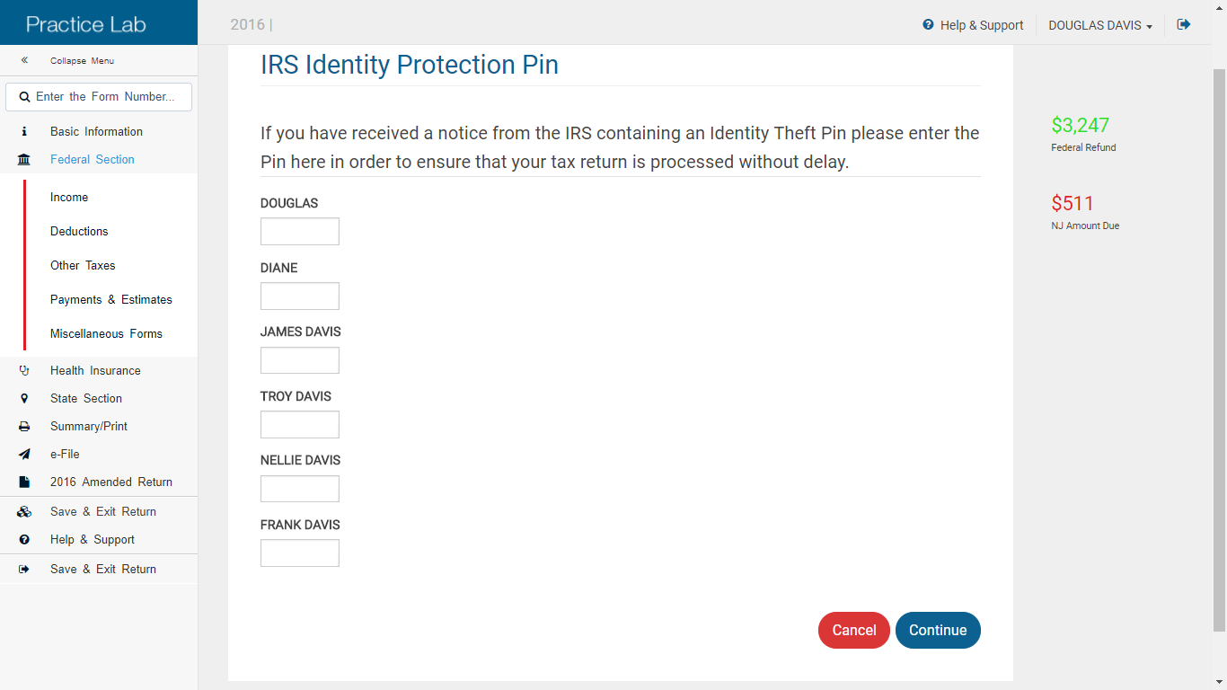
TS – IRS Identity Theft Pin Federal section \ Miscellaneous Forms \ IRS Identification Pin
Enter Identity Theft PIN under appropriate name

Slide 6
Power of Attorney (POA) – Form 2848
Pub 4012 Tab K
Required if someone other than taxpayer is signing return – gives authority for someone else to represent taxpayer with IRS
POA must include authority for income tax returns
Form 2848 can be found in Federal section \ Miscellaneous Forms
E-file tax return. After return is accepted, mail POA to IRS along with Form 8453 “U.S. Individual Income Tax Transmittal for an IRS e-file Return”
On Form 8453, check box to indicate that Form 2848 is being sent
Notes:
Check the client’s Power of Attorney document to make sure it covers Tax Returns.
A “General Power of Attorney” permits the agent to conduct every kind of business or financial transaction.
A “Limited Power of Attorney” permits the agent to perform a specific act or acts
Also check that the dates on the Power of Attorney are active.
6

Slide 7
Carryforward Data
Normal carryforward of data from return prepared at site for previous tax year
Extended carryforward of data from return prepared at any TaxAide site the previous tax year
For 2018 filing season only (2017 tax year)
Global carryforward - Question in E-file section for taxpayer to agree (or not) to cross VITA/TCE carryforward for filing season 2019+ (tax year 2018 onward)
Notes:
7

Slide 8
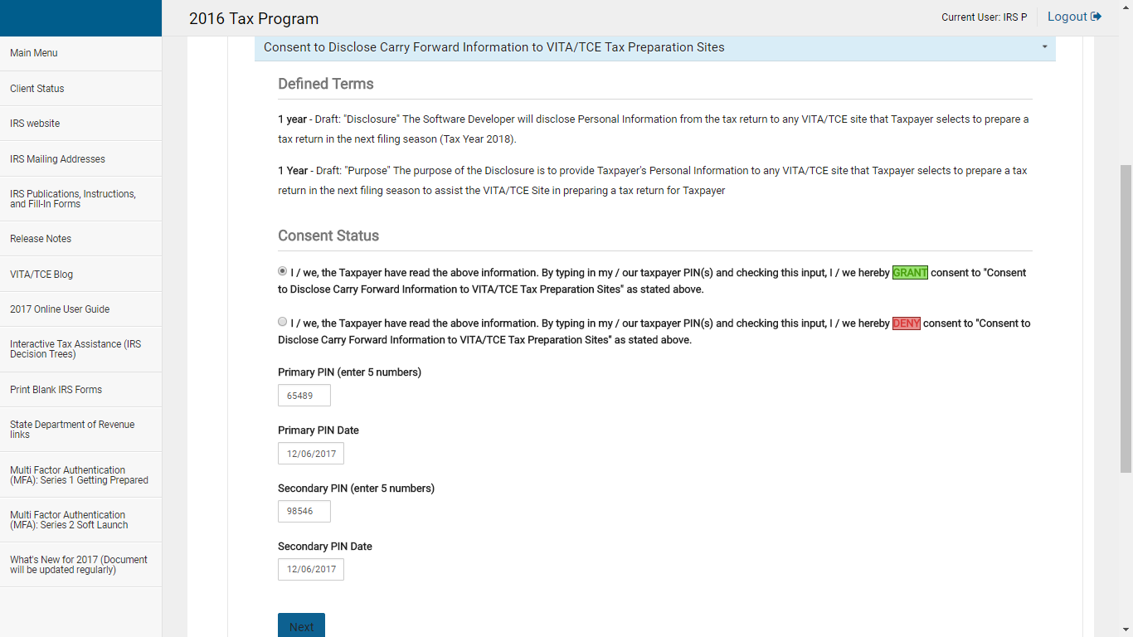
TS – Consent to Disclose Carryforward Information to VITA/TCE Tax Preparation Sites
Grant or deny consent for global carryforward data for next tax year
Taxpayer PIN and date for consent
Spouse PIN and date for consent
Notes:
8

Slide 9
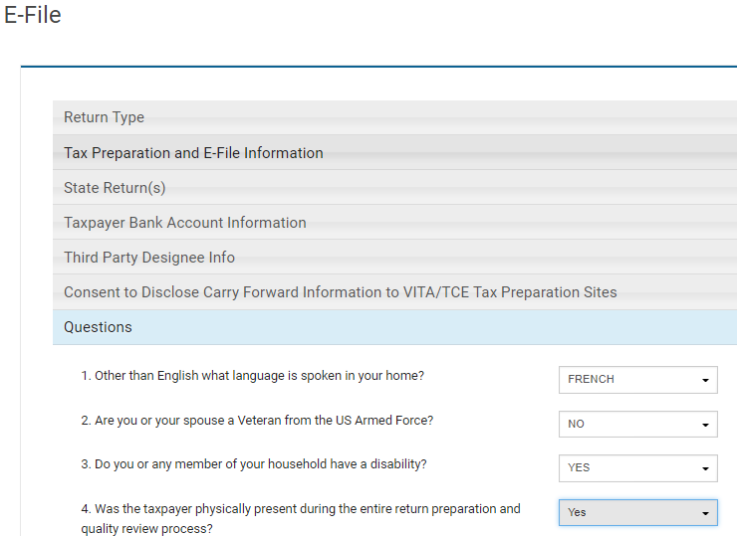
TS – Questions in E-File Section
Pub 4012 Tab K
Answer questions in E-File section
Language spoken in home
Veteran status
Disability status
Taxpayer physically present
Notes:
9

Slide 10
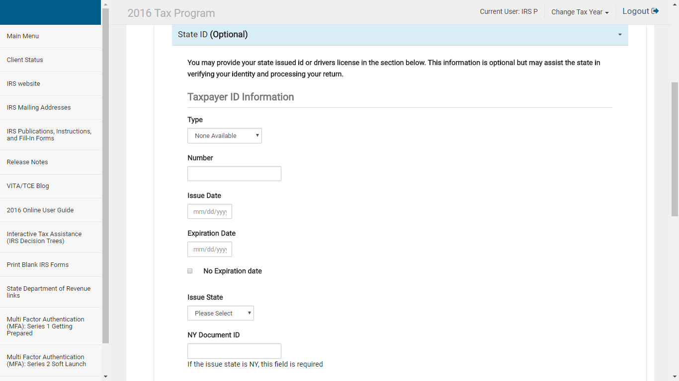
TS – State ID (Optional)
Pub 4012 Tab K
To help prevent fraud, enter information
from drivers license or state issued ID
(optional for NJ)
Notes:
10

Slide 11
TS – Finalizing Return in TaxSlayer
Pub 4012 Tab K
Print copy of return for taxpayer
Print from e-File section of return
Click on Print Return Button on Submission page
Print from Welcome page
Click on printer icon next to taxpayer’s name in Office Client list
Choose a print set from drop-down menu
Click Print Return
ERO will e-file returns & notify counselor of any rejects that need to be fixed
Notes:
11

Slide 12
Finalizing Return with Taxpayer
Pub 4012 Tab K
Review printed return with taxpayer
Ask taxpayer to check spelling on names, SSNs, and address on top of 1040.
Review line by line Federal & NJ 1040s
Highlight any carry-overs or “issues”
Have taxpayer(s) sign Form 8879 IRS E-File Signature Authorization
Inform taxpayers they are responsible for return
If joint return, BOTH taxpayers MUST sign
Signatures acknowledge they know they are responsible for return and also gives permission to e-file
Assemble packet for taxpayer in envelope
Return all source documents, Intake/Interview sheet, signed 8879 – DO NOT KEEP ANY TAXPAYER DOCUMENTS
Notes:
Emphasize that there is a rule that we must inform taxpayers they are responsible for return
Read paragraph from 8879
12

Slide 13
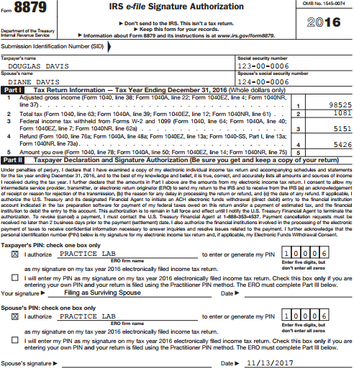
TS IRS E-file Signature Authorization - Form 8879
Inform taxpayer(s) they are responsible for return
and have them sign form
Taxpayer signature; spouse also must sign
if MFJ
Notes:
Taxpayer & Spouse must both sign Form 8879
Inform taxpayers they are responsible for accuracy of return
Not just signing to allow e-filing
Do not need to keep copy of 8879 or Federal copy of W-2s & 1099s to give to ERO
8879 is given back to taxpayer(s) in envelope
13

Slide 14
TS - E-file Signature Authorization – Form 8879
Pub 4012 Tabs 13 & 14
If one spouse has died before signing return, surviving spouse can sign for the deceased and enter “Filing as surviving spouse” in signature area
If changes to the tax return are made after Form 8879 is signed, taxpayer/spouse may need to sign a new 8879, depending on the changes
If total income or AGI changes by more than $50
If total tax, Federal income tax withheld, or amount you owe changes by more than $14
If changes are made to any credit on the return
Notes:
14

Slide 15
Refunds/Balance Due
Pub 4012 Tabs 13 & 14
Discuss expected date/method of refund
Review payment alternatives if balance due
Can e-file now & pay by 4/17 (for 2017 returns) with payment voucher (1040-V)
Discuss how to avoid balance due in future
Increase withholdings from wages (W-4)
Request withholding from pension, SS, broker
Make estimated tax payments
Assist with Form 1040-ES vouchers
Notes:
15

Slide 16
The Last Word
Explain what will happen next
Site responsibility
Taxpayer’s responsibility
Ask taxpayer if any questions
Remind taxpayer to bring current year tax envelope with them next year
Ask taxpayer to refer friends to program
Thank taxpayer for coming
Notes:
16

